Slide 1
Class diagram 2

Slide 2
Hubungan Object pada class diagram
Association
Generalization
Aggregation

Slide 3
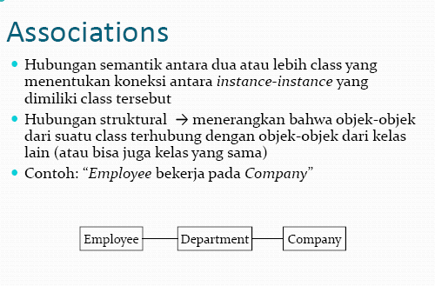

Slide 4
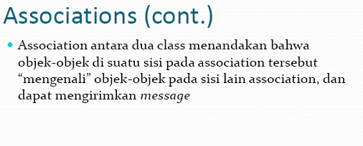

Slide 5
An association has two ends. An end may have a role name to clarify the nature of the association.
A navigability arrow on an association shows which direction the association can be traversed or queried.

Slide 6
Multiplicity association
The multiplicity of an association end is the number of possible instances of the class associated with a single instance of the other end. Multiplicities are single numbers or ranges of numbers. In our example, there can be only one Customer for each Order, but a Customer can have any number of Orders.

Slide 7
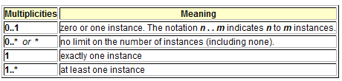
This table gives the most common multiplicities.
Every class diagram has classes, associations, and multiplicities. Navigability and roles are optional items placed in a diagram to provide clarity.

Slide 8
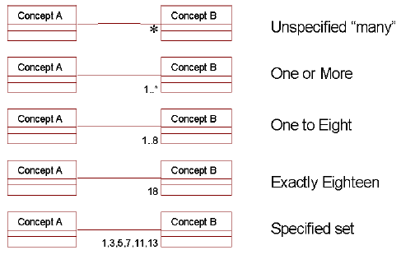

Slide 9
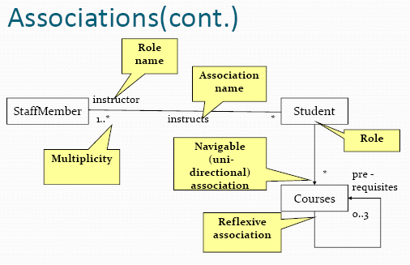

Slide 10
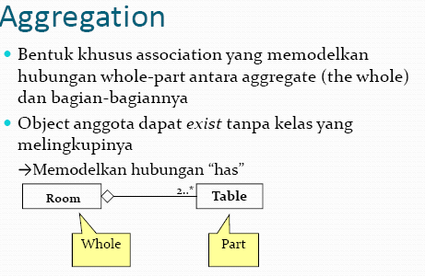
Aggregation

Slide 11
Generalization
generalization
-- an inheritance link indicating one class is a superclass of the other. A generalization has a triangle pointing to the superclass. Payment is a superclass of Cash, Check, and Credit.

Slide 12
Multiplicity association
The multiplicity of an association end is the number of possible instances of the class associated with a single instance of the other end. Multiplicities are single numbers or ranges of numbers. In our example, there can be only one Customer for each Order, but a Customer can have any number of Orders.

Slide 13
This table gives the most common multiplicities.
Every class diagram has classes, associations, and multiplicities. Navigability and roles are optional items placed in a diagram to provide clarity.

